Slide 1
Quantum Computing Architectures (EE274) Lecture 2
Hiu-Yung Wong
Jan. 27, 2025
hiuyung.wong@sjsu.edu, Office: ENG363
http://www.sjsu.edu/people/hiuyung.wong/index.html

Slide 2
Outline
Finishing up the introduction to quantum information
Overview of quantum hardware
Linear Algebra – vector space, Euclidean space, Hilbert space, dual correspondence, inner product and measurement

Slide 3
Announcement
I will post some questions on Canvas every week
Do not contribute to the final grade
They are easy and are good for you to review some fundamental concepts

Slide 4
Quantum Information Part II

Slide 5

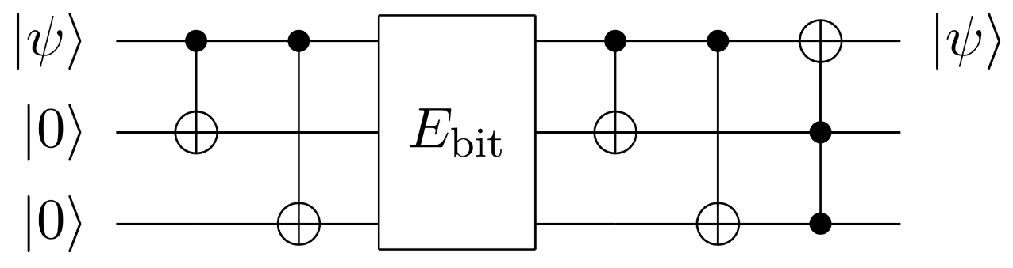
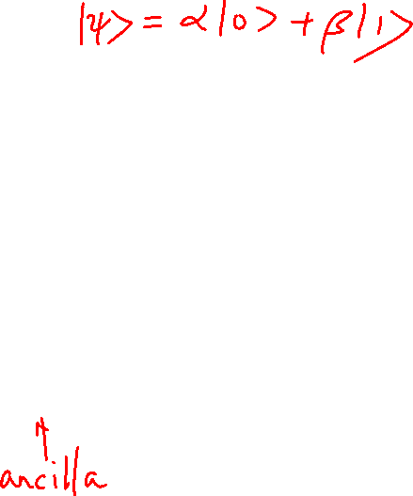

Error Correction
No-Cloning Theorem: It is not allowed to copy an arbitrary state in quantum mechanics
Syndrome measurement is used for error correction
Classical Error Correction
Quantum Error Correction
$$0⇒000$$
$$1⇒111$$
E.g. Through entanglement and syndrome measurement

Slide 6
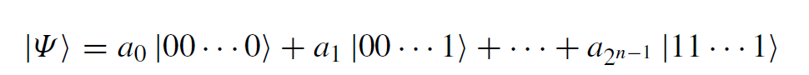

Final Remark: Is Quantum Computing Omnipotent?
Each state contains profound amount of information, but we cannot extract them with reasonable resources. How do we get the a’s?
QC is suitable for answering questions that classical computers cannot answer well. Often, destructive and constructive interferences are used to obtain the answers.
E.g. Is the function balanced? What is the period of the function?
QC cannot replace classical computer but can be a very powerful accelerator for difficult problems, e.g. optimization problems.

Slide 7
How does a Quantum Computer look like?
Chapter 1 of “Quantum Computing Architecture and Hardware for Engineers: Step by Step”
- An engineer’s perspective

Slide 8


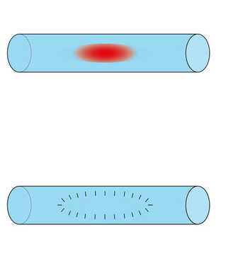
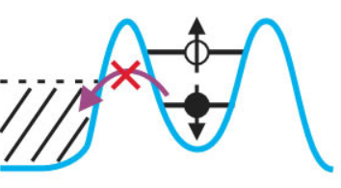
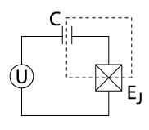
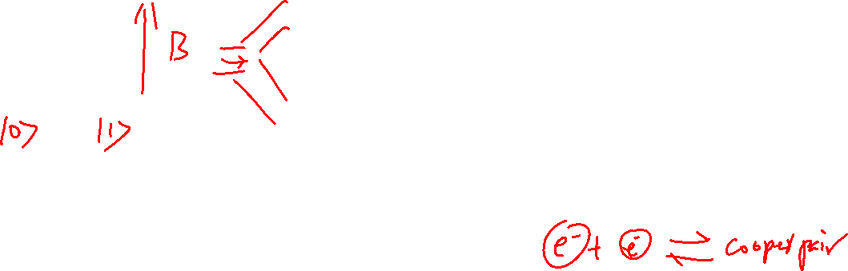



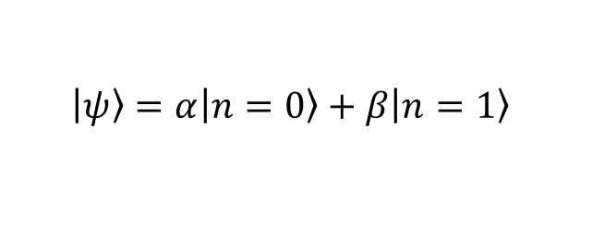

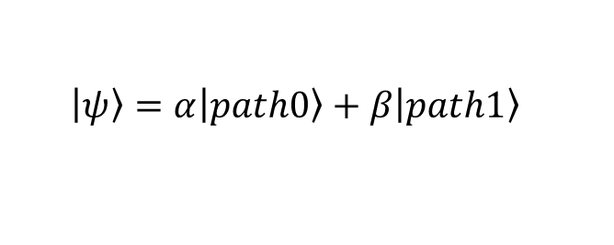
Implementations of “boring” Qubits
$$\left.\left|Mood\right.\right\rangle =α\left.\left|\right.\right\rangle +β\left.\left|\right.\right\rangle$$
Not a reliable qubit
Electron Spin Qubit
Photonic Qubit
Superconducting Charge Qubit
$$path1$$
$$n$$
$path$0
$$\left.\left|\right.\right\rangle =α\left.\left|\right.\right\rangle +β\left.\left|\right.\right\rangle$$
$$\left.\left|ψ\right.\right\rangle =α\left.\left|path0\right.\right\rangle +β\left.\left|path1\right.\right\rangle$$
$$\left.\left|ψ\right.\right\rangle =α\left.\left|n=0\right.\right\rangle +β\left.\left|n=1\right.\right\rangle$$
Physics Today 72, 8, 38 (2019)
Scientific Reports 3, 1394 (2013)
Wikipedia

Slide 9
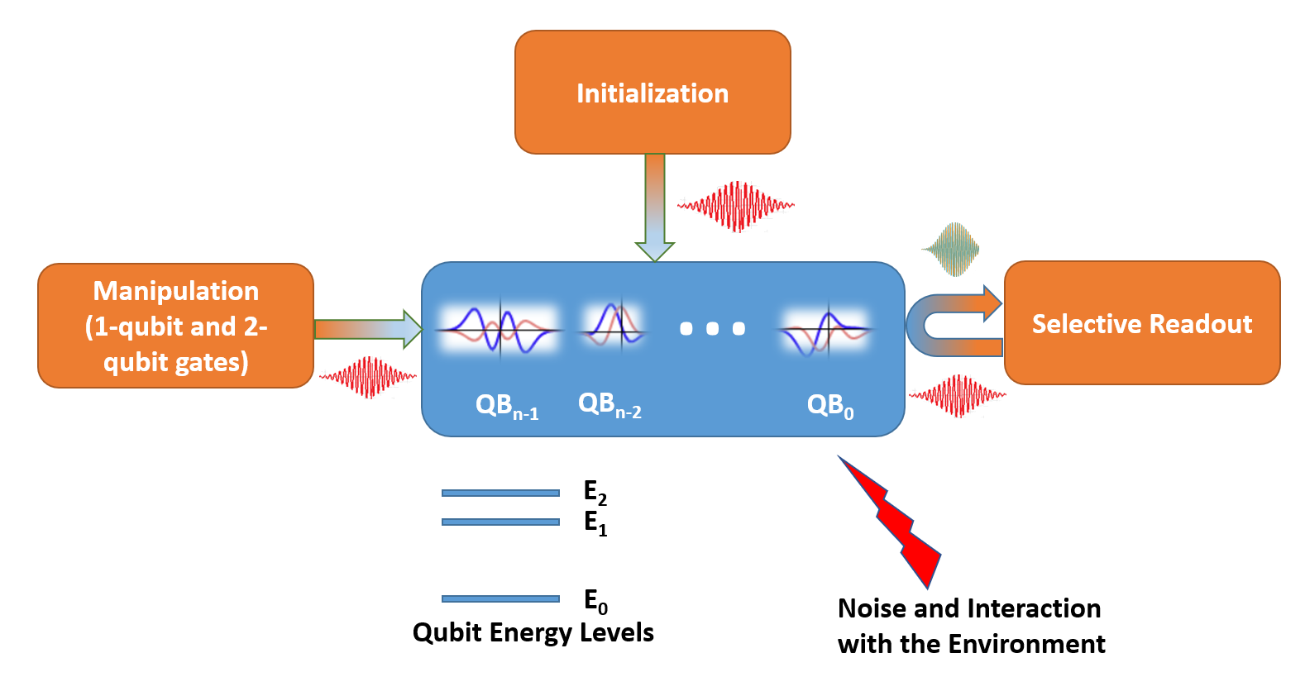

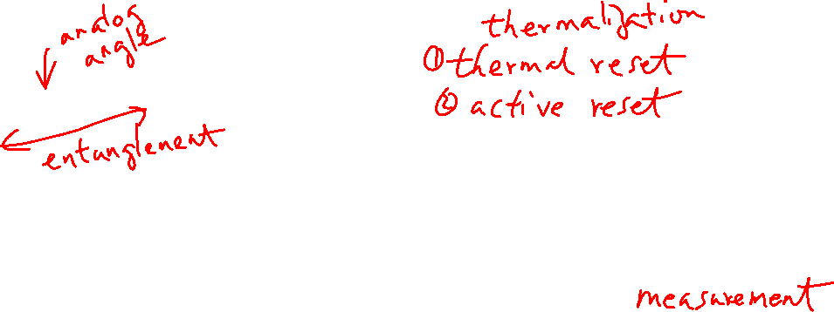
What is a Quantum Computer (“exciting”)? Classical Electronics-Controlled-Wavefunction
Universal Sets of Gate:
Pulses:
right frequency
right shape
right amplitude
right phase
right time
right duration

Slide 10
DiVincenzo’s Criteria
5 Necessary Criteria for quantum computing:
The ability to initialize the state of the qubits to a simple fiducial state (initialization time is important)
A "universal" set of quantum gates (1-qubit gates + entanglement gate)
A qubit-specific measurement capability (Some algorithms only work without measuring all qubits at the same time e.g. teleportation)
A scalable physical system with well-characterized qubit (system needs to remain in the 2-level subspace) (see next slide)
Long relevant decoherence times (much longer than gate time) (see next slide)
Dilemma: long decoherence time usually has a long gate time

Slide 11
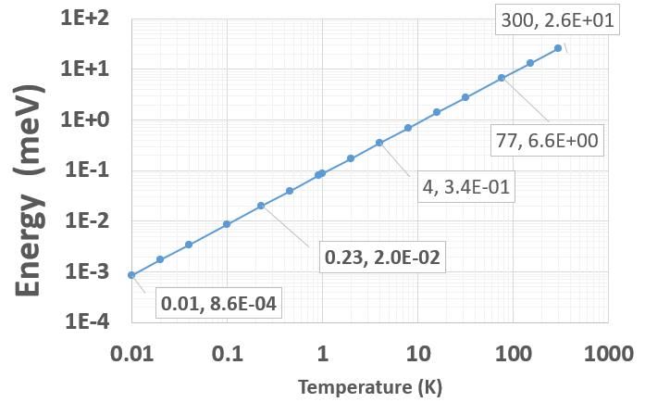
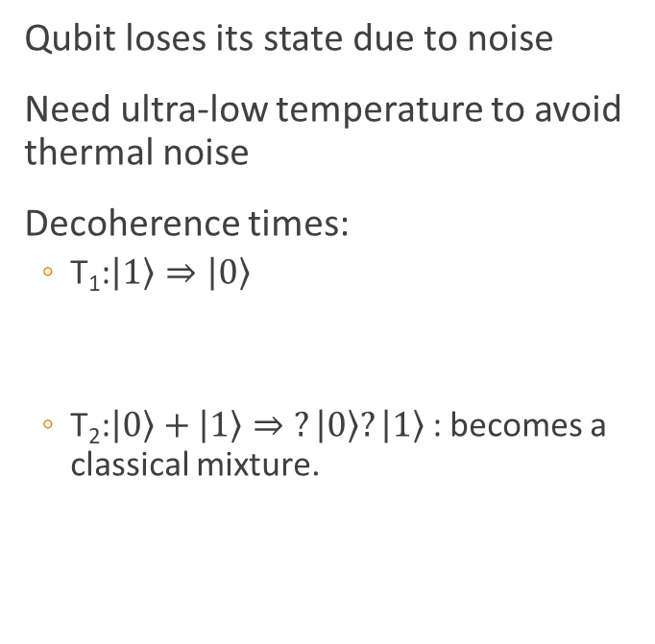
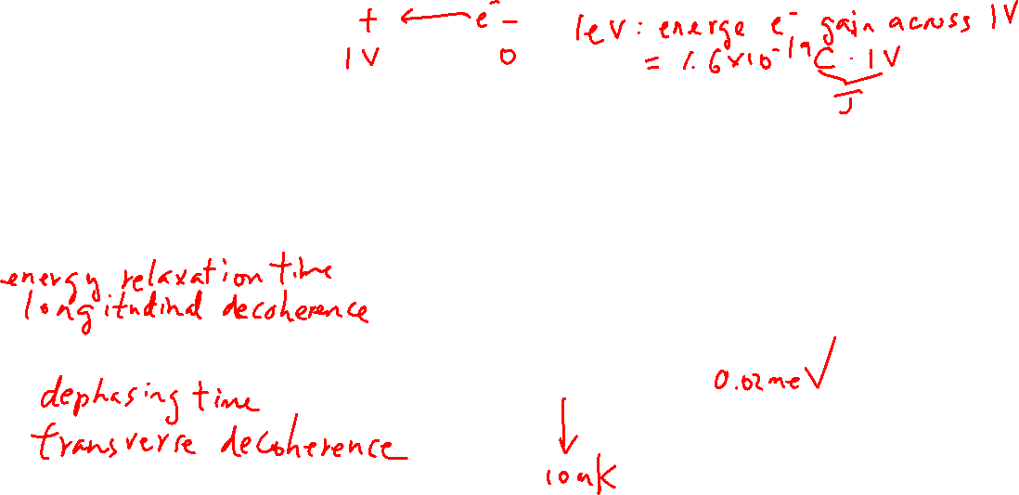
Noise, De-coherence Time and Energy Scale
Qubit loses its state due to noise
Need ultra-low temperature to avoid thermal noise
Decoherence times:
T₁:$\left.\left|1\right.\right\rangle ⇒\left.\left|0\right.\right\rangle$
T₂:$\left.\left|0\right.\right\rangle +\left.\left|1\right.\right\rangle ⇒\left.?\left|0\right.\right\rangle ?\left.\left|1\right.\right\rangle$ : becomes a classical mixture.
Qubit energy separation
Liquid-He
Dilution Fridge
Liquid-N

Slide 12
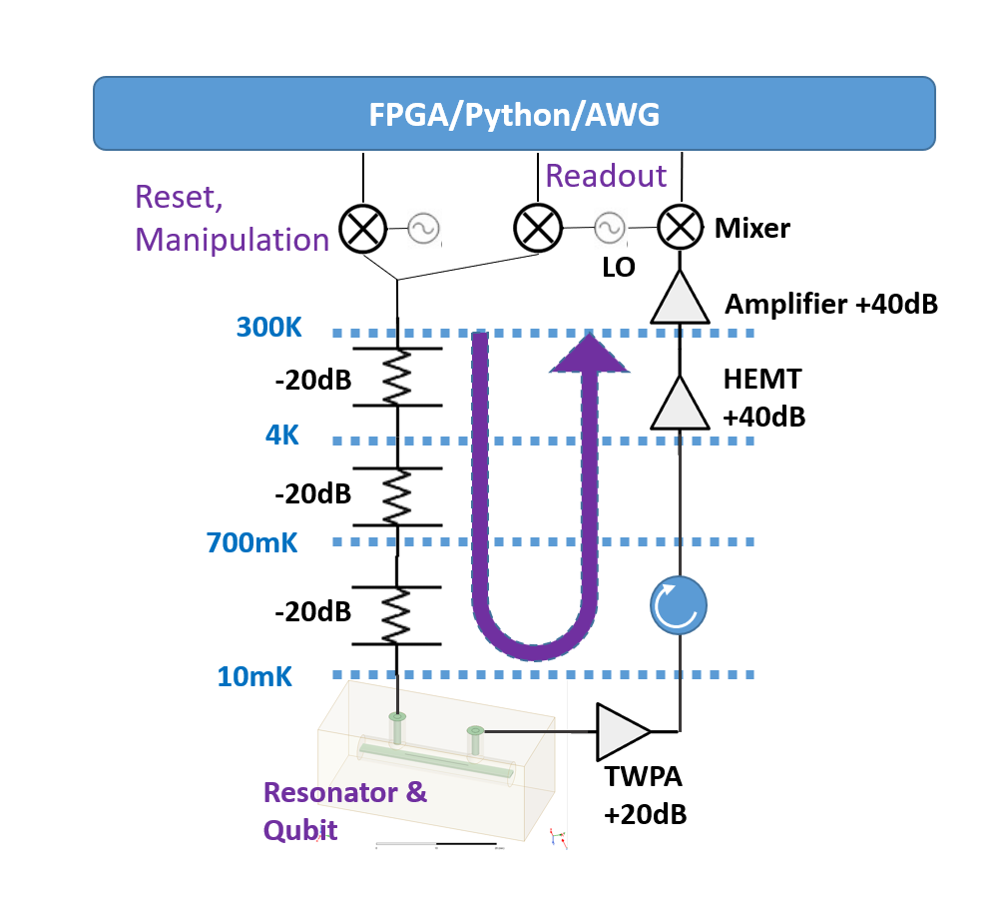

Superconducting Qubit System Overview

Slide 13

Scaling of Quantum Computers
How to wire millions of cables to the dilution refrigerator?
Throughput
Noise
Cooling power of the dilution refrigerator (<1mW)
E.g. 20μW at 20mK
Put electronics at 4.2 K
Error correction:
100 - 1000 physical qubits to implement 1 error protected logical qubit

Slide 14
Linear Algebra
Chapter 2 of “Quantum Computing Architecture and Hardware for Engineers: Step by Step”
Introduction to Quantum Computing From a Layperson to a Programmer in 30 Steps – YouTube
https://www.youtube.com/playlist?list=PLnK6MrIqGXsJfcBdppW3CKJ858zR8P4eP
Lectures 3 - 8

Slide 15
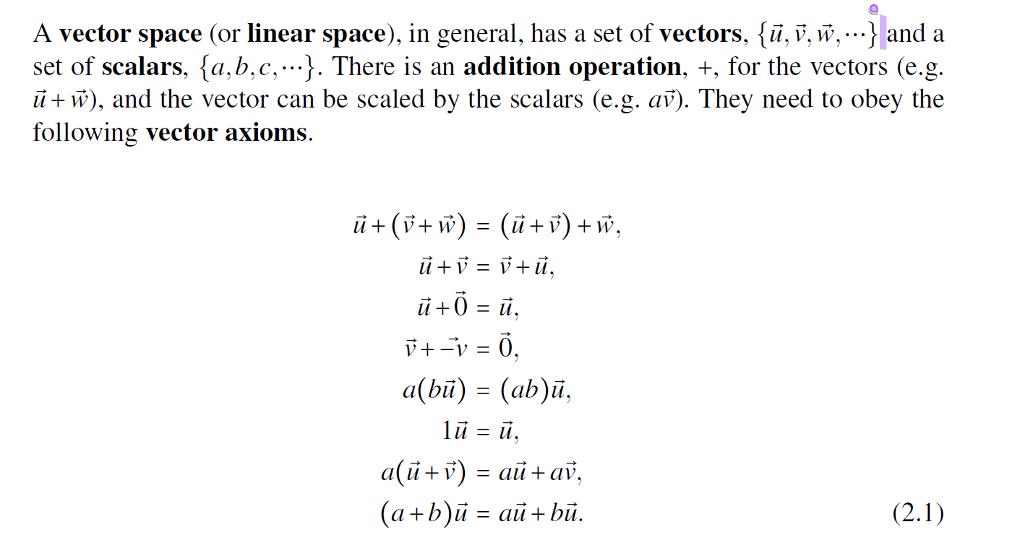
Vector Space
Learning outcomes:
No need to memorize, just use whatever you have learned about vectors

Slide 16

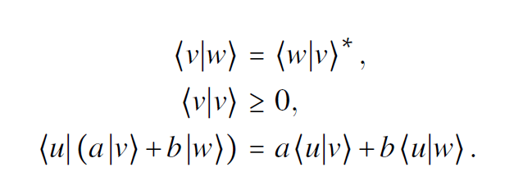
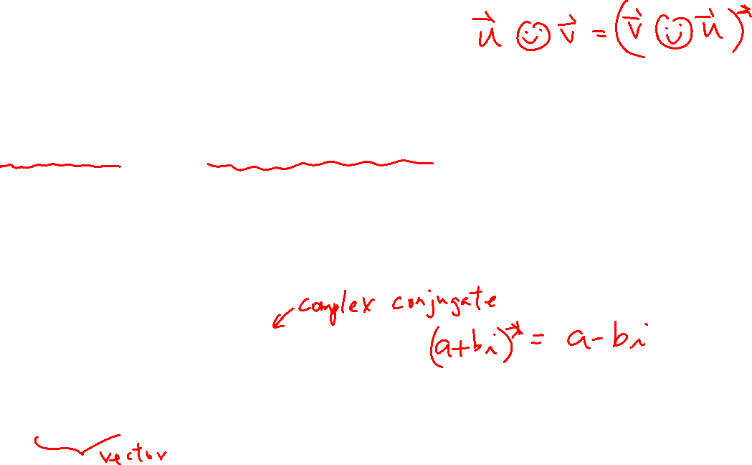
Inner Product Space
A vector space with an inner product defined.
where the inner product should satisfy the following equations:

Slide 17
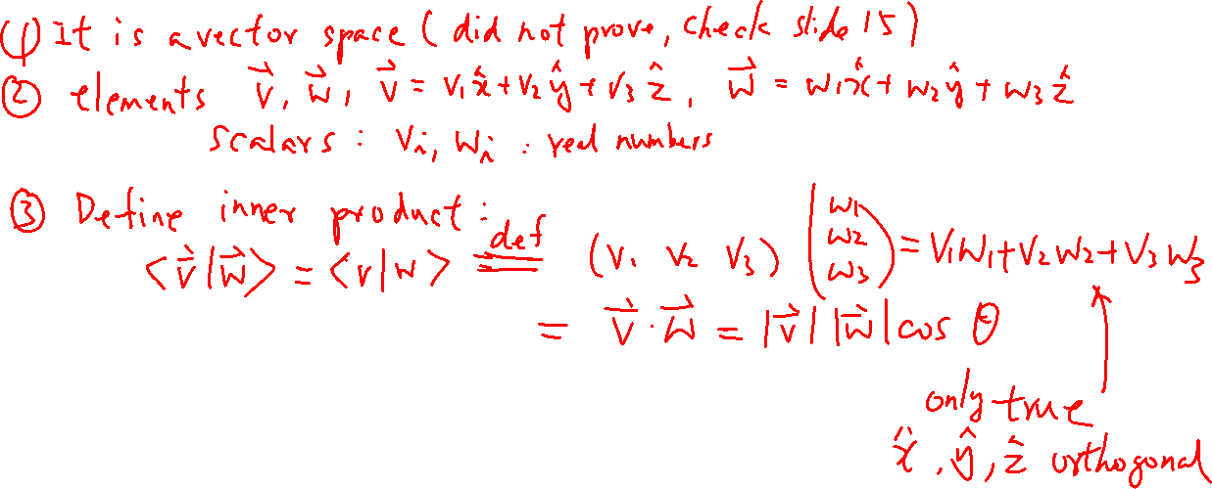
Euclidean Vector Space is an Inner Product Space
Learning outcomes:
Vector space can be something as simple as the space we live in.

Slide 18
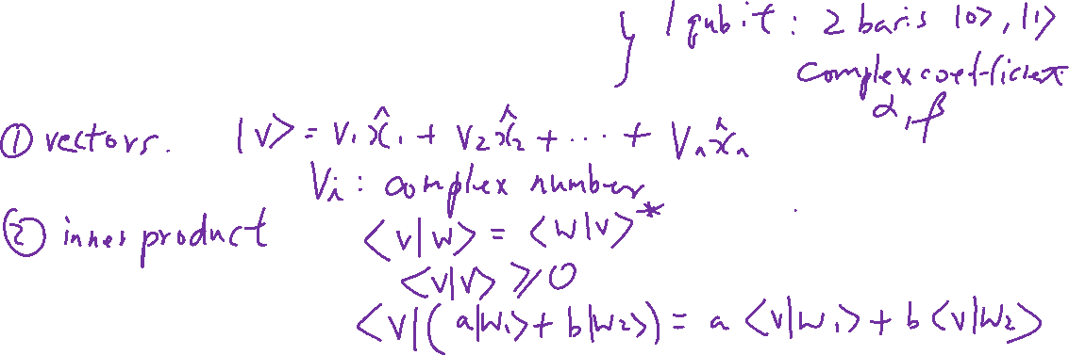
Hilbert Space
Learning outcomes:
A space is not necessary something we can feel.
A complete linear space with an inner product
Euclidean space is also a Hilbert space. But for a general Hilbert space,
it can be infinite (infinite number of basis vectors)
it has complex scalar
We show the physics convention

Slide 19
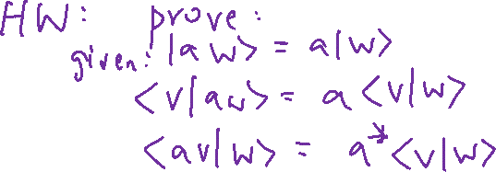
Learning outcomes:
The rules define a space; You need to trust it and obey it and be comfortable with it.

Slide 20
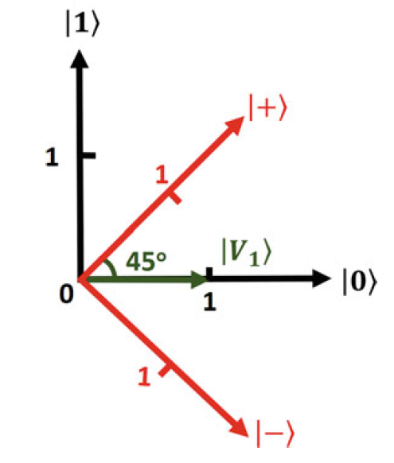
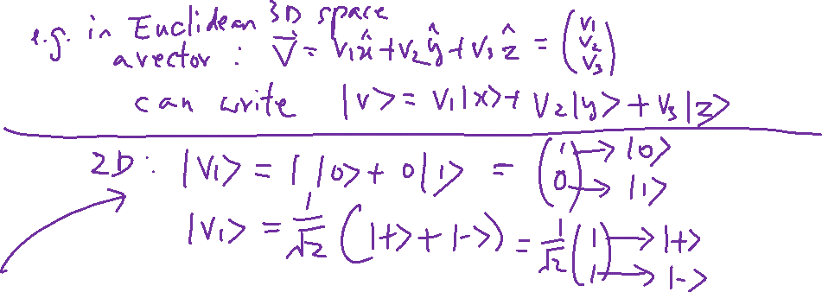
Basis States/Vectors and Representation of States/Vectors
Learning outcomes: Basis vector is just like the alphabet in English. Sometimes you don’t ask what “A”, “B”, “C” are made of.

